Slide 1


CLOUD ISO
Your ICT and Digital Transformation Solutions Provider
System Development Cost Proposal

Slide 2

About Us
◇ Tech Star started in 2013, our mission is to help corporations to solve problem with technologies.
◇ We do customise solutions for clients from different industry in several countries
◇ IT Partner of several corporation on system development, growth strategies and research.
70+ clients
180+ projects

Slide 3








We Do
Mobile banking, Payments & MCommerce
Real time analytics
Navigation & Tracking
Business Automation
Internet of things
Augmented Reality
Mobile Gaming & Learning
Cloud driven apps

Slide 4










































Tech Star Clients

Slide 5













Our Solutions Partners

Slide 6
Our Company
We are system integration and software development company that provide ICT solution based on what our customer needs. We develop and customise enterprise software applications to resolve your operation issue, deliver the reliable system on time and implement the best value IT solution for our customers. Our project consultants and software engineers have more than 7 years of experiences in enterprise and mobile app implementation for SME and corporate customers.

Slide 7

The Big Idea
To design and develop a Cloud based ISO web-based portal to Create forms from templates, customise forms, share them online, receive instant alerts, efficiently manage the data and view reports.
To set up an approval hierarchy and automate task assignment. Bring your team on board to review, edit, and collaborate on the data.
To facilitate each respective departments to take corrective actions and to make necessary actions for service providers to maintain perfect logs.
To set reminders for respective departments.

Slide 8
Deliverables
Web Portal for customers
Admin CMS

Slide 9
Project Scope
Overview
To prepare pre defined customised templates
To prepare compressing forms
To set reminders
To prepare reassessment forms in excel
To set footer information on documents
To prepare Outgoing quality control and inspection criteria report
To get customers survey
Backend
Super Admin will login to the dashboard with the credentials provided.
Dashboard will display a list of customers with forms created.
User Types
Different types of user levels:
Super admin who will manage everything.
Admin who will manage everything except admin user creations.
HR will set training matrices and summary of training details
Vendor Manager will evaluate total complaints record, questionnaire approval process.
Customer will fill forms based on the pre defined templates, survey forms, and submit complaints.

Slide 10
Form Creation - How It Works!
Create Forms (Choose from a template) + Customize if requires
Approval from HOD or superior
Publish & Share forms (share with your target audience - other departments, other companies, groups, etc)
Audience Complete & Submit the forms
View Data & Reports

Slide 11
Service Team Work Flow
Track Check-in and Check-out time
Receive Customer Signature
System track Live location of service person
Receives Task

Slide 12
Risk Register Flow
Find Risk
Provide Mitigation Plan
Check Severity
Check Significant or not
Check Occurrence
Calculate Risk Scores
Check Detection

Slide 13
Production Flow
Enter customer enquiry no and date
Enter operator (employee no)
Sales coordinator receives PO
Enter Breakdown Time
Enter downtime
Key in Sales order No
Find planned job and machine
Enter Start and Complete date
Fill Maintenance Form

Slide 14
Quality Control Flow
6. Monitor every 6 months
1. Customer gets OQC Form
5. Calculate OQC Pass score (10 out of 10 is 100%, 8 out of 10 is 80%)
2. Customer Inspects things
4. OQC Log is updated automatically
3. Update QC Pass or Fail

Slide 15
Risk Assessment
Severity
Occurrence
Deduction

Slide 16
Documentation Footer Format
Effective Date
Revision Number
Document Number
Document Name
Revision Date

Slide 17
Report Types
Outgoing Quality Control Report
Inspection Criteria Report
Corrective Action Report

Slide 18

Cloud ISO
Service
Reporting
Project
Management
Tracking &
Monitoring
Dashboard
HR
Notification
Evaluation
User
Module
Department
Document
Management
Customer
Management
Vendor
Management

Slide 19
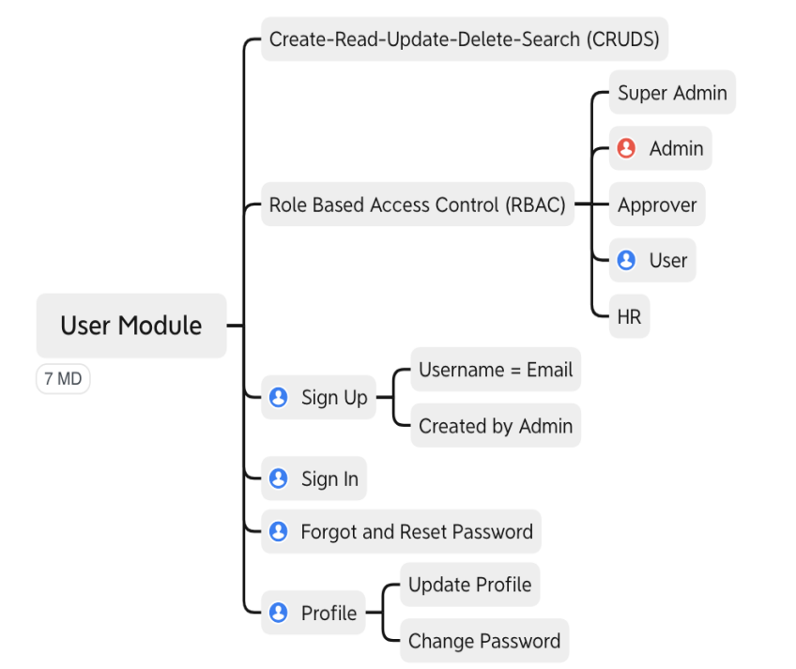
User Module

Slide 20
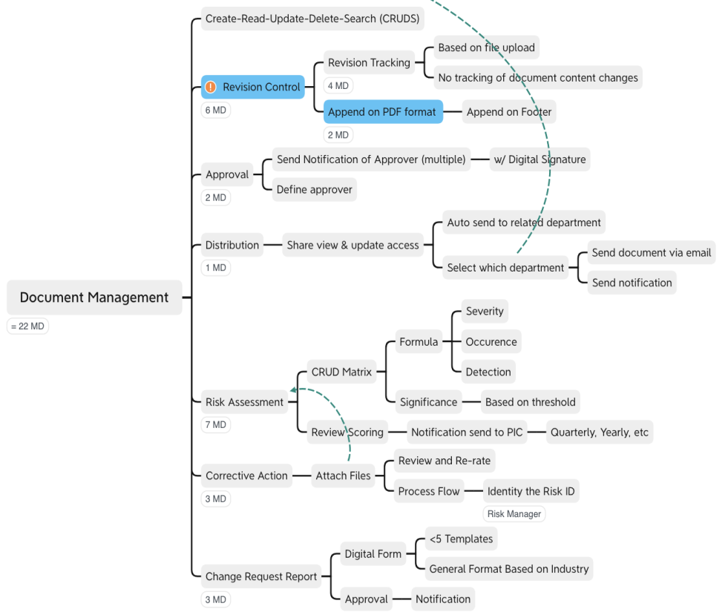
Department & Documents Management Module

Slide 21
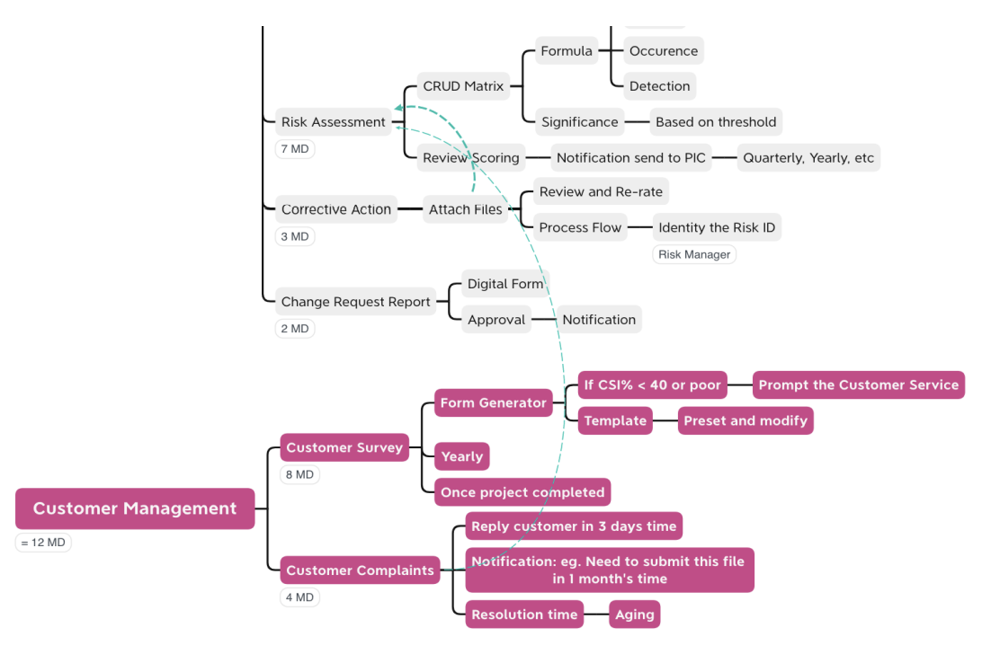
Customer Management Module

Slide 22
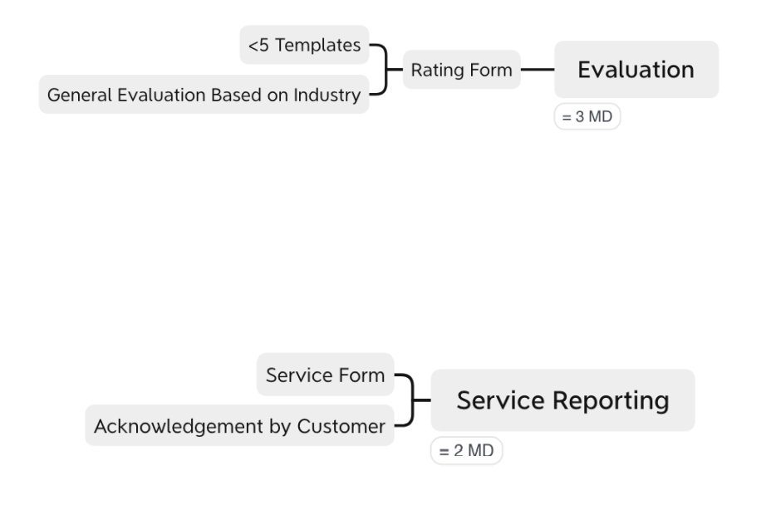
Cloud ISO Operation Module

Slide 23
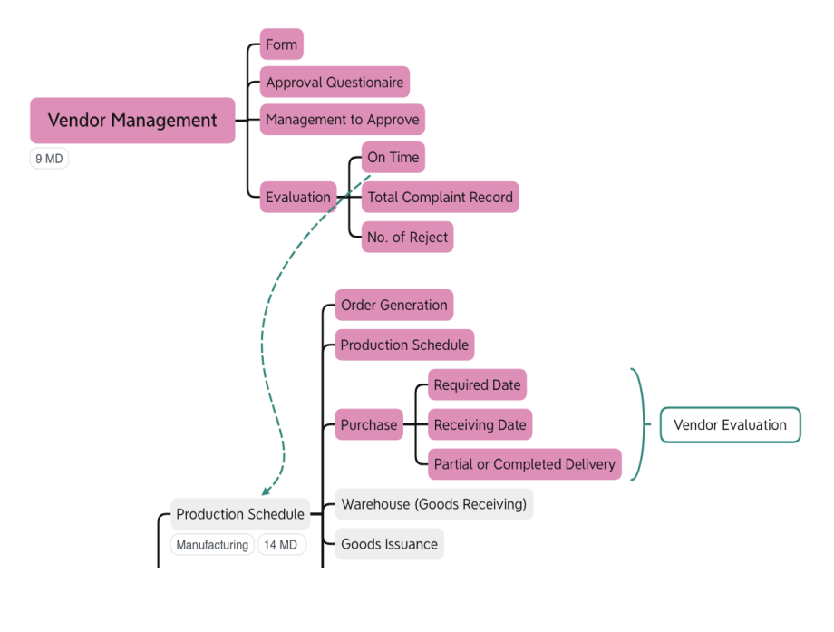
Vendor Management Module

Slide 24
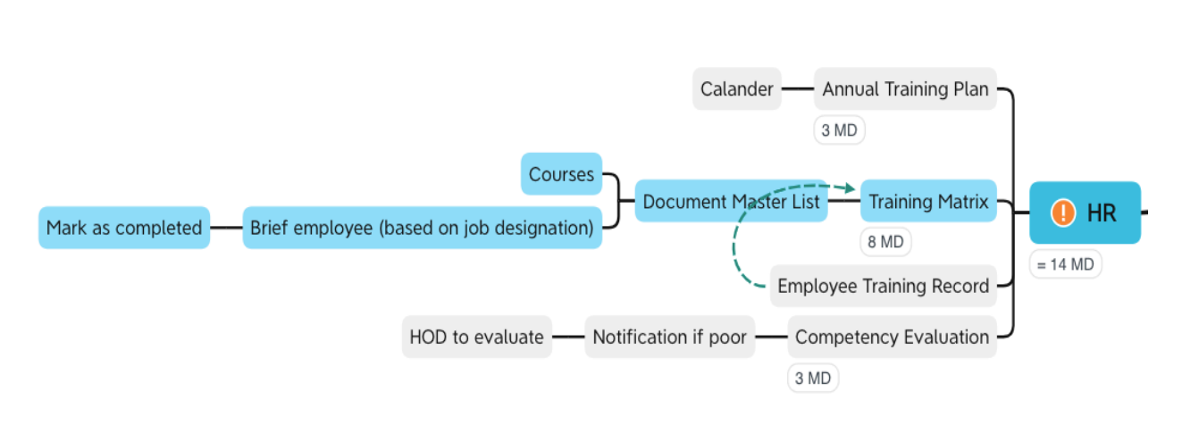
HR Module

Slide 25
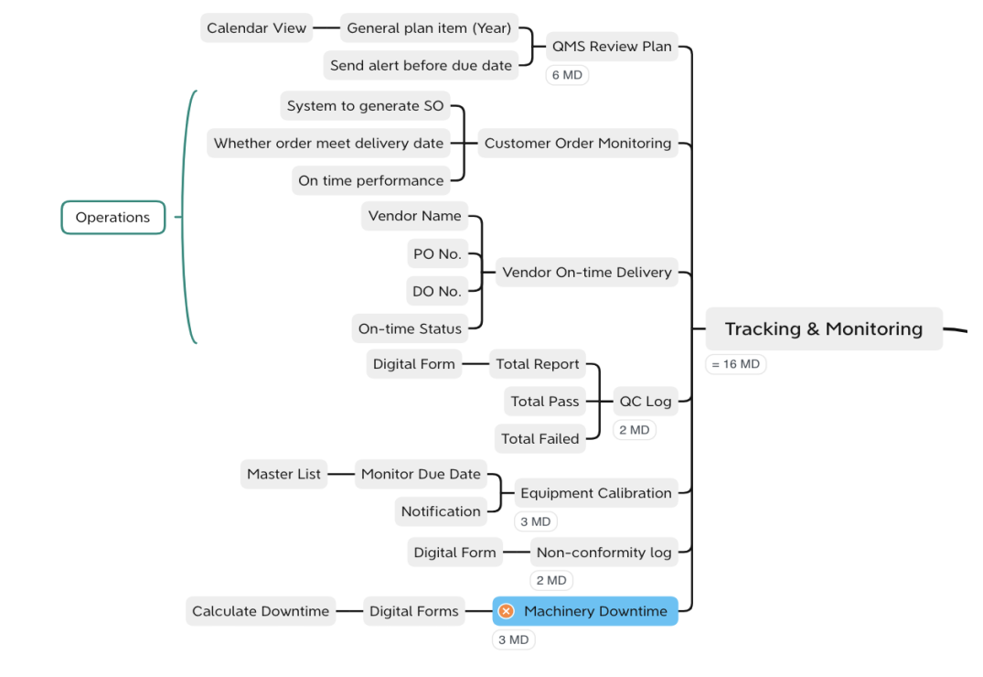
Tracking & Monitoring Module

Slide 26
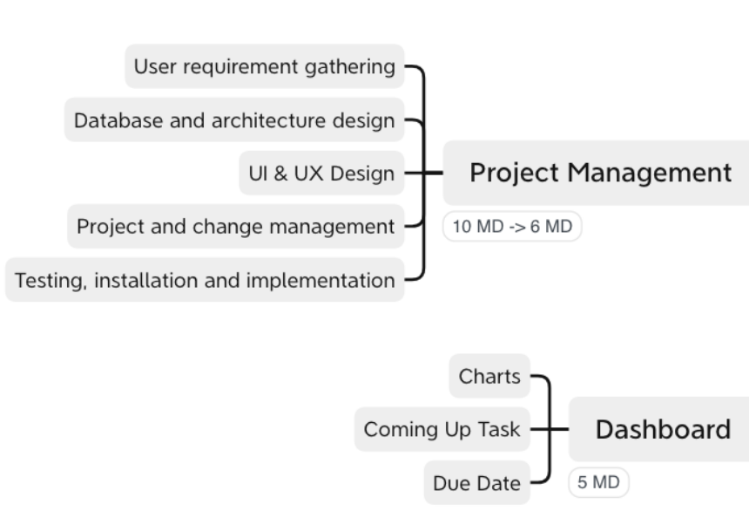
Project Management & Dashboard Module

Slide 27
Key Features
Create Read
Update Delete
Search
Column for Editing
Pre-designed
Templates
Role Based Access Control
Trainee metrics
Append on
Footer
Tracking & Monitoring
Risk Management
Instant Notifications
Acknowledgement
Pre Defined Templates
Annual Training
QC Log
Machinery Downtime
Revision
Control
Submission Reports
Compressing Forms
Reminders
Reassessment
Revised number
Outgoing quality control report
Inspection criteria
customer survey
Production Tracking
Live location
Sales order no

Slide 28
Work Breakdown Structure
Requirement Gathering and Documentation
UI Graphic Design
UI Implementation
Customer Application System
Dashboard
Charts
Coming up Task
Due Date
User Module
Create Read Update Delete Search
Role Based Access Control
Super Admin
Admin
Approver
User
HR
Sign Up
Username
Email
Sign In
Forgot and Reset Password
Profile
Update Profile
Change Password
Department and Documents Management Module
Create Read Update Delete Search
Revision Control
Revision Tracking
Based on File Upload
No Tracking of document content changes
Append on PDF format
Append on Footer
Approval
Send Notification of approver (Multiple)
w/ Digital Signature
Select which Department
Distribution
Share view & update access
Auto send to related department
Select which department
Select document via email
Send notification

Slide 29
Work Breakdown Structure
Customer Management Module
Risk Assessment
Create Read Update Delete Search Matrix
Formula
Occurrence
Detection
Review Scoring
Notification Sent to PIC
Quarterly, Yearly, etc.
Corrective Action
Attach Files
Review and Rerate
Process Flow
Identify the Risk ID
Change Request Report
Digital Report
Approval
Notification
Customer Management
Customer Survey
Form Generator
If CSI% < 40 or poor
Prompt the customer service
Template
Preset and Modify
Yearly
Once Project completed
Customer Complaints
Reply customer in 3 days time
Notification: eg: Need to submit this file in 1 month time
Resolution time
Aging
Cloud ISO Operation Module
Evaluation
Rating Form
<5 Templates
General Evaluation Based on Industry

Slide 30
Work Breakdown Structure
Service Reporting
Service Form
Acknowledgement by Customer
Vendor Management Module
Form
Approval Questionnaire
Management to Approve
Evaluation
On time
Total Complaint Record
No. of receipt
Production Schedule
Order Generation
Production Schedule
Purchase
Required Date
Receiving Date
Partial or completed delivery
HR Module
Annual Training Plan
Calendar
Training Matrix
Document Master List
Courses
Brief employee (based on job description)
Mark as completed
Employee Training Record
Competency Evaluation
Notification if poor
HOD to evaluate
Tracking & Monitoring Module
Tracking & Monitoring
QMS Review Plan
General Plan item (year)
Calendar View
Send alert before due date

Slide 31
Work Breakdown Structure
Customer Order Monitoring
System to generate SO
Whether order meet delivery date
On time performance
Vendor On-time Delivery
Vendor Name
PO No
DO No
On-time Status
QC Log
Total Report
Digital Form
Total Pass
Total failed
Equipment Calibration
Monitor Due Date
Master List
Notification
Non-conformity log
Digital Form
Machinery Downtime
Digital Forms
Calculate Downtime
Test
UAT
Build

Slide 32
Technology Stack
Description | Technology
Backend Programing language | PHP Laravel
Database | MySql
Frontend | HTML5, CSS3, JavaScript, JQuery

Slide 33
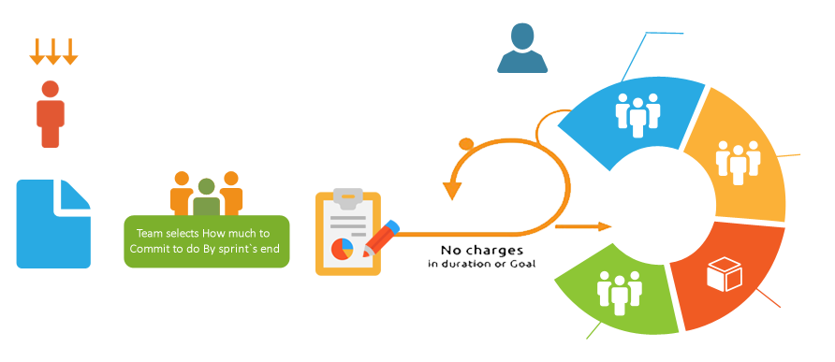








Our Development Strategy
We are specialised in Agile Scrum/XP
Daily Scrum Meeting &
Artifacts Update
Input from End-Users, Customers,
Team and Other Stackholders
SCRUM MASTER
Team
Review
PRODUCT OWNER
Sprint
1-4 weeks
Product
Backlog
Sprint Planning Meeting
(Parts One and Two)
Potentially
Shippable Product
Increment
Retrospective

Slide 34



Resource Plan
OFFSHORE TEAM
Team Member Role | FTE
Project Manager | 1
Business Analyst | 1
Web Developer | 1
Mobile Developer | 1
Test Engineers | 1
PROJECT
MANAGER
BUSINESS ANALYST
MOBILE DEVELOPER
WEB DEVELOPER
TEST ENGINEER

Slide 35
Approximate Timeframe
Requirement Gathering, Analysis & Documentation
Weeks
01-02
Design and Development Completion
Weeks
03-10
UAT Release, Sign off & Deployment
Weeks
11-12
Note:
We will be sharing regular build hosted in our server, from Month 2 onwards
The given project delivery plan is based on our regular resource planning. In case of any deadline we can tweak the plan based on mutual consent.

Slide 36
Cost
Description | Cost(RM)
- Cloud based ISO web portal for customers Admin CMS (backend) | 58,000
TOTAL | 58,000

Slide 37
OUR WORKFLOW
1
Project Proposal
2
Contract
We will send a customised project proposal.
Signing up the contract to get started.
3
Invoice, Payment & Onboarding
4
Client Calls & Communications
Invoice from us and payment from you. Fill the form to get started with the project.
A call to understand the technicalities of the work. All our conversations take place in our WhatsApp, email, or Zoom call (recorded).
5
Agile Development & Feedback
6
Integration & Testing
Collecting and responding to client feedback is what makes agile software development lean.
Various software modules are combined and tested as a group.
7
UAT
8
Release & Handover
UAT is the last phase of the software testing process. During this, actual software users test the software to make sure it is developed according to specifications.
The final release and handover is done with a handover documentations such as User Manuals, Tutorial videos, etc.

Slide 38

Encryption & Data Protection
Data encryption is the method of translating data into another form or code so that access to the data is limited to only those with the correct decryption key (or password).
Encrypted data, sometimes referred to as cipher-text, is one of the most popular and widespread forms of data security.
All the key datas such are passwords, PIN numbers, etc. are encrypted and stored.
Using digital signatures we can maintain the integrity of our data in transit. This will prevent hackers intercepting communications and tampering with the data, as doing so could be easily checked by the recipient.

Slide 39

Authentication, Security & Compliance
Role-based access control (RBAC) restricts network access based on a person's role within an organisation and has become one of the main methods for advanced access control. The roles in RBAC refer to the levels of access that employees have to the network. This decreases the risk of breaches and data leakage.
Audit Logs: An audit log is a document that records an event in an information (IT) technology system. In addition to documenting what resources were accessed, audit log entries usually include destination and source addresses, a timestamp and user login information.
Error Logs: An error log is a record of critical errors that are encountered by the application, operating system or server while in operation. Some of the common entries in an error log include table corruption and configuration corruption.
SSL Certification (https): SSL stands for Secure Sockets Layer and, in short, it's the standard technology for keeping an internet connection secure and safeguarding any sensitive data that is being sent between two systems, preventing criminals from reading and modifying any information transferred, including potential personal details.

Slide 40

Our Promises
TOP CODE QUALITY
Most sophisticated, readable, scalable and reusable coding techniques are the guidelines.
We abide for the seamless software development process.
NON-DISCLOSURE AGREEMENT
Privacy and confidentiality of our clients are regarded by signing the NDA.
We provide safe & secure exchange of knowledge and data to protect client information.
SUPPORT & MAINTENANCE
Our services comes with support & maintenance.
We maintain and constant upgrade our products according to the latest technologies and versions.
We have different support & maintenance packages available to suit your requirements.

Slide 41
Assumption
The project will be hosted in client provided server after the UAT.
The estimate covers the efforts for developing functionalities mentioned in Work Breakdown Structure section.
The estimates are based on requirement shared by the client.
We assume that the stakeholders will be available for clarifications and support throughout the project time frame
All contents will be provided client.
Source codes will release to client upon full payment made
Web hosting for production and beta testing will be provided by client

Slide 42
THANK YOU
Please feel free to contact us if you need further clarification or information.
We will be happy to assist you.
https://techstar.my
Contact: Ray Low 017-3102898
raylow.biz@gmail.com / ray@techstar.my

